Slide 1
CSE 3218 - Lab1
Introduction to Swift Language
Kaniz Fatema Isha
Lecturer,
CSE, KUET
Md. Repon Islam
Lecturer,
CSE, KUET

Slide 2
Introduction
Swift is a general-purpose programming language built using a modern approach to safety, performance, and software design patterns.
Apple created Swift, an open-source programming language, as a replacement for all languages based on C, including Objective C, C++, and C.
Swift was designed from the outset to be safer than C-based languages, and eliminates entire classes of unsafe code.

Slide 3
Introduction
Swift defines away large classes of common programming errors by adopting modern programming patterns:
Variables are always initialized before use.
Array indices are checked for out-of-bounds errors.
Integers are checked for overflow.
Optionals ensure that nil values are handled explicitly.
Memory is managed automatically using ARC.
Type safe language

Slide 4
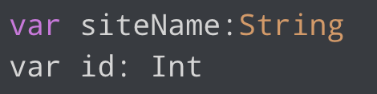
Declaring Constants and Variables
Constants and variables must be declared before they’re used.
The syntax to declare a variable is : var variable_name: Dataype

Slide 5
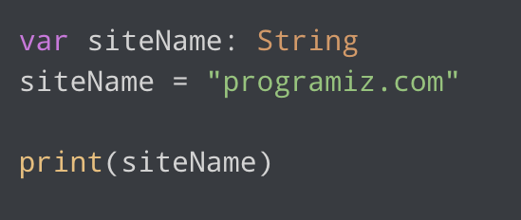

Declaring Constants and Variables
There are 2 ways to assign values into variables:

Slide 6
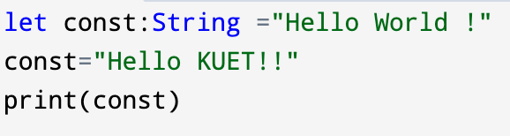
Declaring Constants and Variables
The value of a constant cannot be changed. For example
If we are sure that the value of a variable won't change throughout the program, it's recommended to use let.
ERROR!!

Slide 7
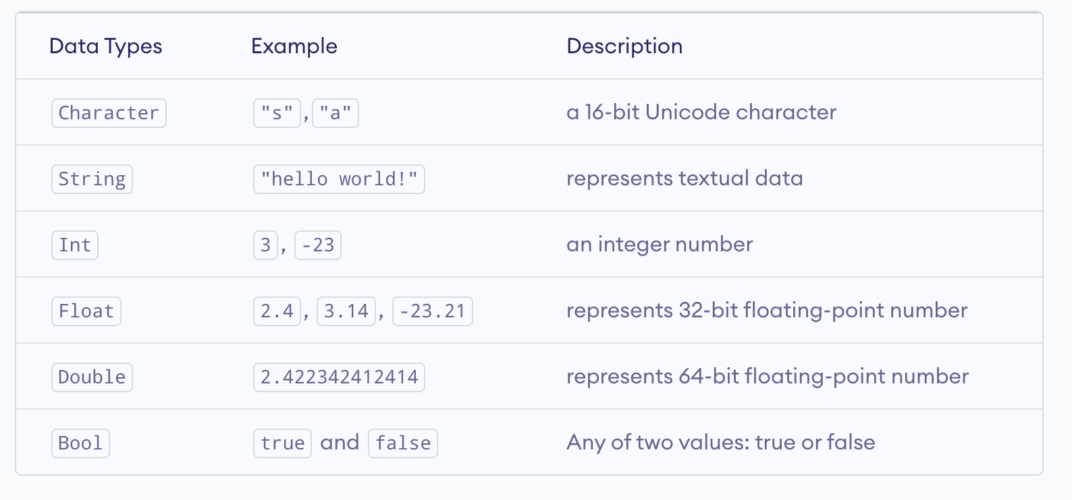
Swift Data Types
There are six basic types of data types in Swift programming.

Slide 8


Swift Input Output
In Swift, we can simply use the print() function to print output. For example,
We can print a string and variable together by using string interpolation

Slide 9
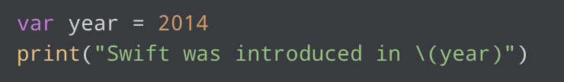

Swift Input Output
We can print a string and variable together by using string interpolation.

Slide 10
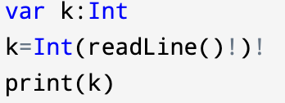
Swift Input Output
We can use the readLine() function to take input from users.
Swift always assumes that the newline is not a part of the input.
Swift takes the input as String. To take input any other Datatype, we must do type conversion:

Slide 11
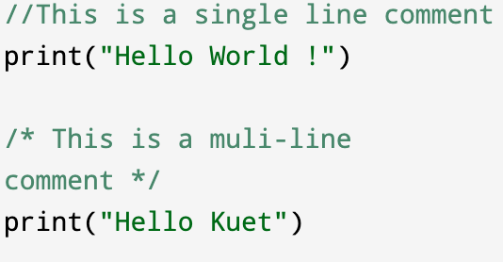
Swift Comments
There are two ways to add comments in Swift:

Slide 12
Swift Operators
There are different types of Swift operators :
Arithmetic operators
Assignment Operators
Comparison Operators
Logical Operators
Bitwise Operators
Special Operators (Ternary,Nil-Coalescing Operator,Range Operator)

Slide 13
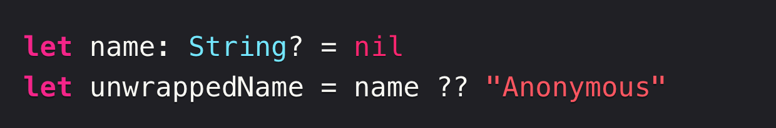
Nil-Coalescing Operator
The nil-coalescing operator (a ?? b) unwraps an optional a if it contains a value, or returns a default value b if a is nil. The expression a is always of an optional type.
The expression b must match the type that’s stored inside a.

Slide 14
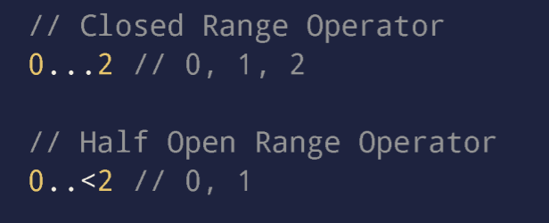
Range Operator
The closed range operator (a...b) defines a range that runs from a to b, and includes the values a and b. The value of a must not be greater than b.
The half-open range operator (a..<b) defines a range that runs from a to b, but doesn’t include b.
Both these operators can also be expressed in One-Sided Ranges.

Slide 15
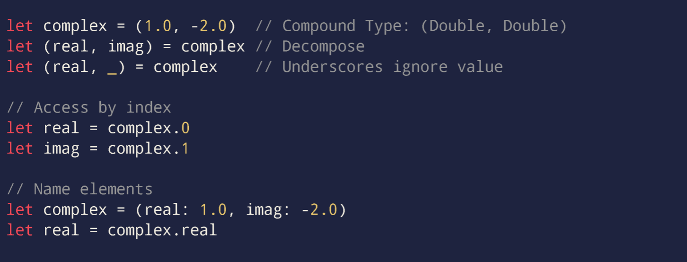
Tuples in Swift
A tuple is a group of different values. Each value inside a tuple can be of different data types.

Slide 16

Optional in Swift
An optional in Swift is basically a constant or variable that can hold a value OR no value. The value can or cannot be nil. It is denoted by appending a “?” after the type declaration
We must “unwrap” an optional to use it. There are 4 ways to unwrap an optional

Slide 17
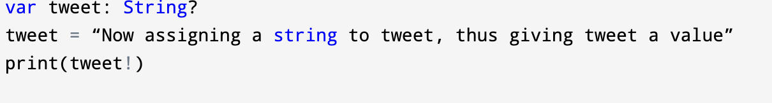
Optional in Swift
Forced Unwrapping:
Forced Unwrapping is denoted by “!” to the optional’s name.
The exclamation indicates the guarantee of optional having a value.
What happens when force unwrapping is applied but there was no value in optional?

Slide 18
Optional in Swift
2. Implicitly Unwrapped Optionals:
Implicitly unwrapped optionals are similar to optionals since they’re allowed to have nil value but they do not need to be checked before accessing.
An implicitly unwrapped optional is declared by placing an exclamation point (String!) rather than a question mark (String?) after the type of the optional.

Slide 19
Optional in Swift
2. Implicitly Unwrapped Optionals:
var assumedInt: Int?
assumedInt = 42
var implicitInt: Int = assumedInt!
print(implicitInt)
var assumedInt: Int!
assumedInt = 42
var implicitInt: Int = assumedInt
print(implicitInt)
42

Slide 20
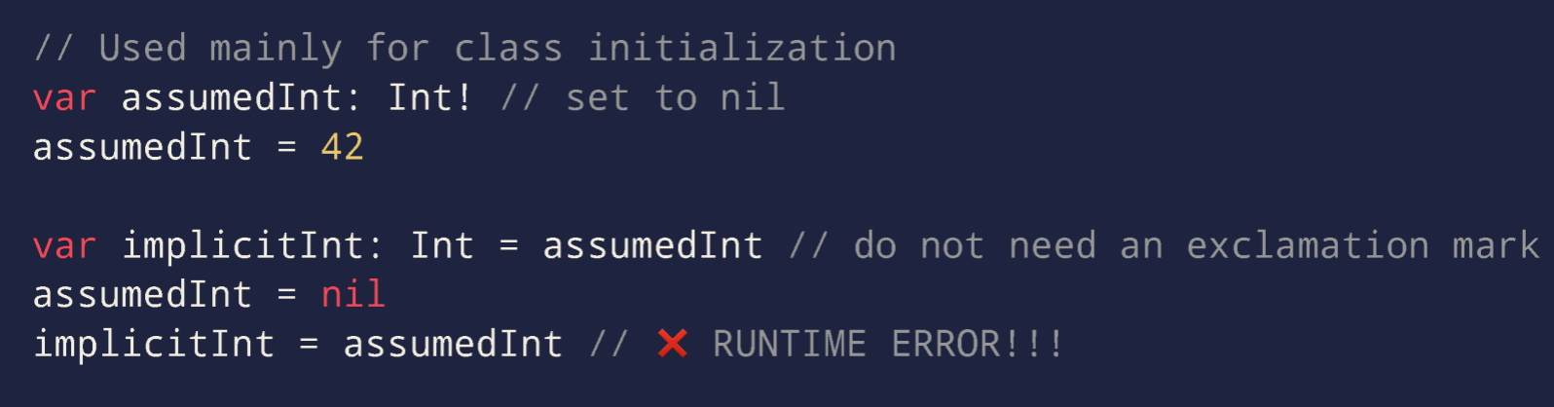
Optional in Swift
2. Implicitly Unwrapped Optionals:

Slide 21
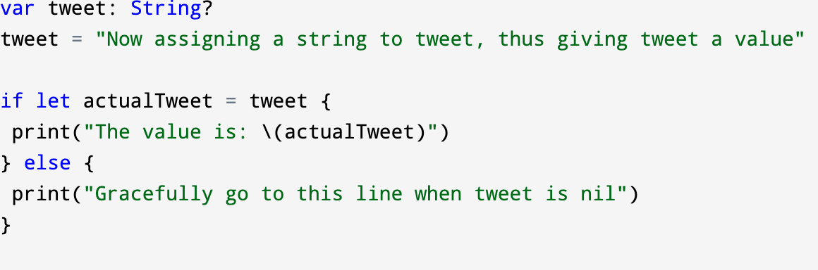
Optional in Swift
3. Optional Binding:
In this case, we check if a variable has a value or not by writing a codeblock:

Slide 22
Optional in Swift
4. Guard Statement :
The guard statement is used to transfer program control out of scope when certain conditions are not met.
This is similar to if-else statement but a bit cleaner.

Slide 23
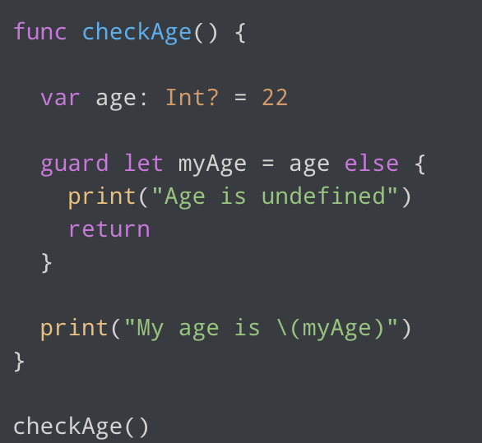
Optional in Swift
My age is 22

Slide 24
if-else in Swift
In Swift, there are three forms of the if...else statement.
if statement
if...else statement
if...else if...else statement

Slide 25
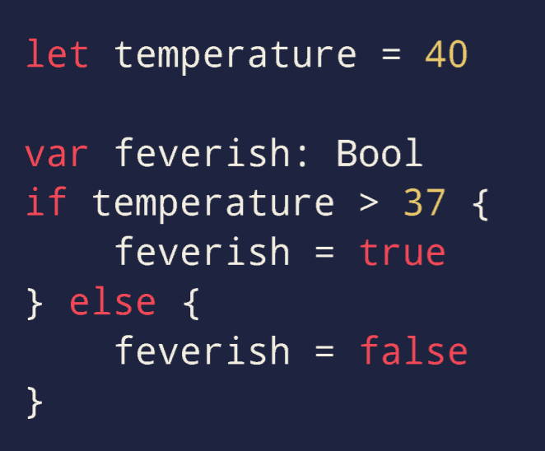
if-else in Swift

Slide 26
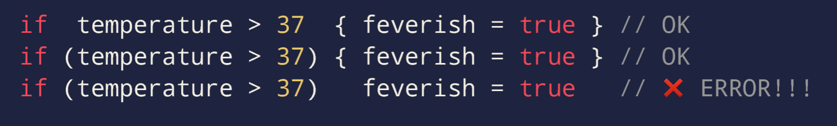
if-else in Swift
Parenthesis() are optional and by convention are often omitted
But Braces{} are always required even if the body contains only one statement.

Slide 27
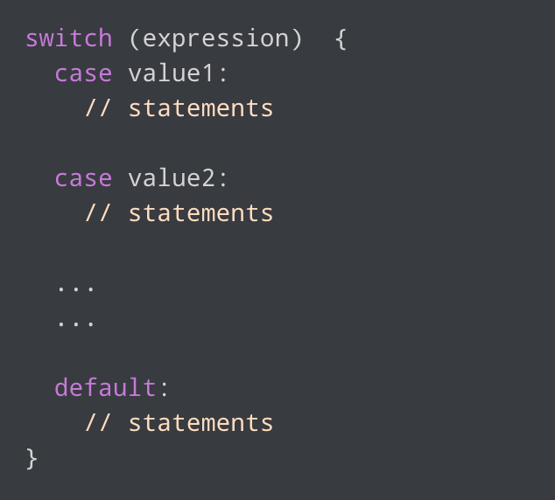
Switch in Swift
The syntax of the switch statement in Swift is:

Slide 28
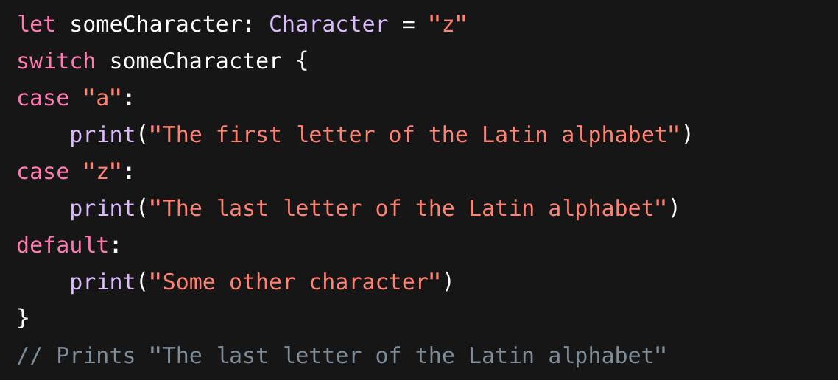
Switch in Swift
Example:

Slide 29
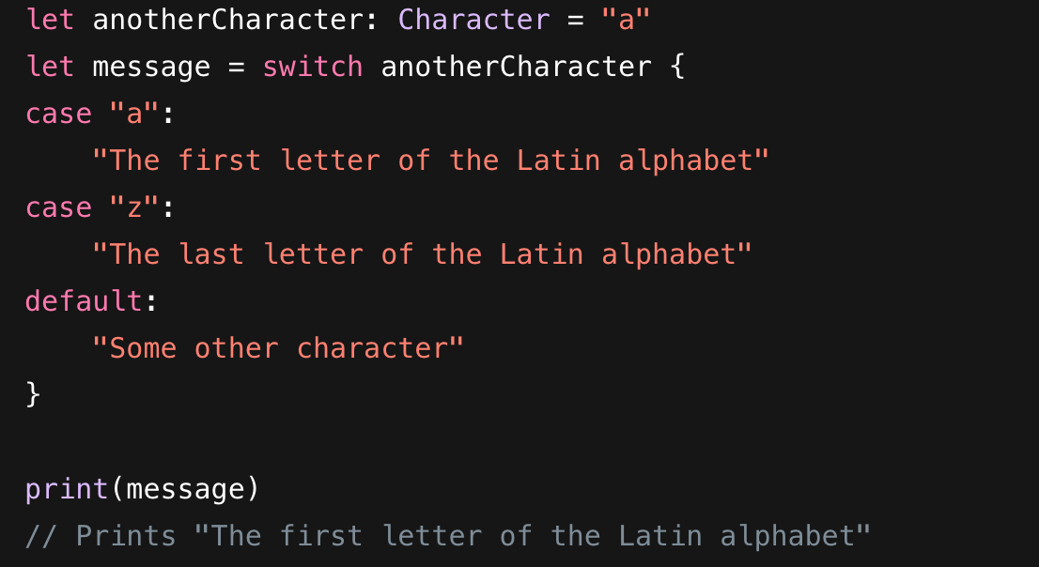
Switch in Swift
Example:

Slide 30
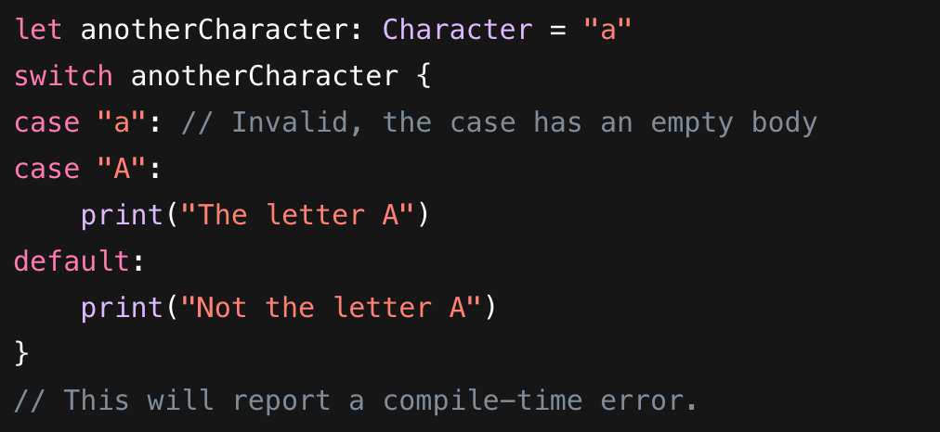
Switch in Swift
Switch is always exhaustive, there is always a value to assign.

Slide 31
Switch in Swift
Generally, switch cases in Swift doesnt require break to choose the statements of the chosen case.
However, if we use the fallthrough keyword inside the case statement, the control proceeds to the next case even if the case value does not match with the switch expression.

Slide 32
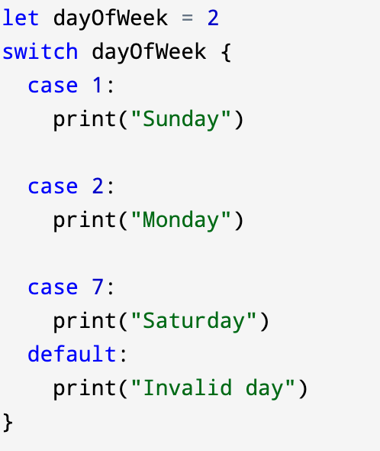

Switch in Swift

Slide 33
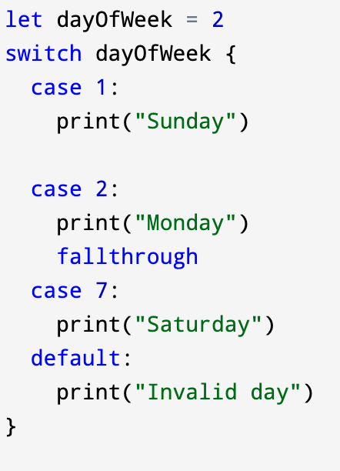
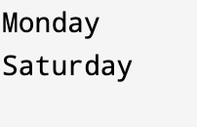
Switch in Swift

Slide 34
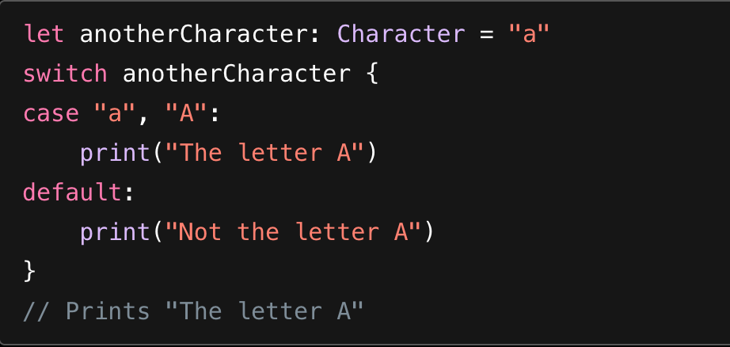
Switch in Swift
We can generate compound cases.

Slide 35
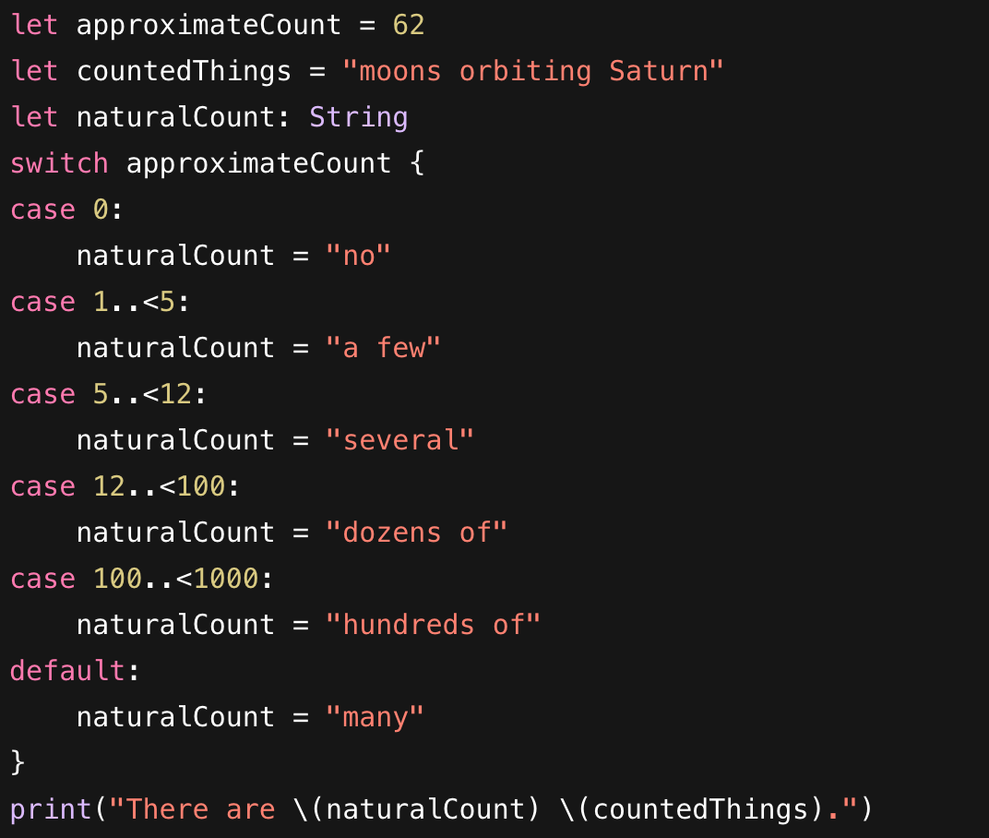
Switch in Swift
Values in switch cases can be checked for their inclusion in an interval.

Slide 36
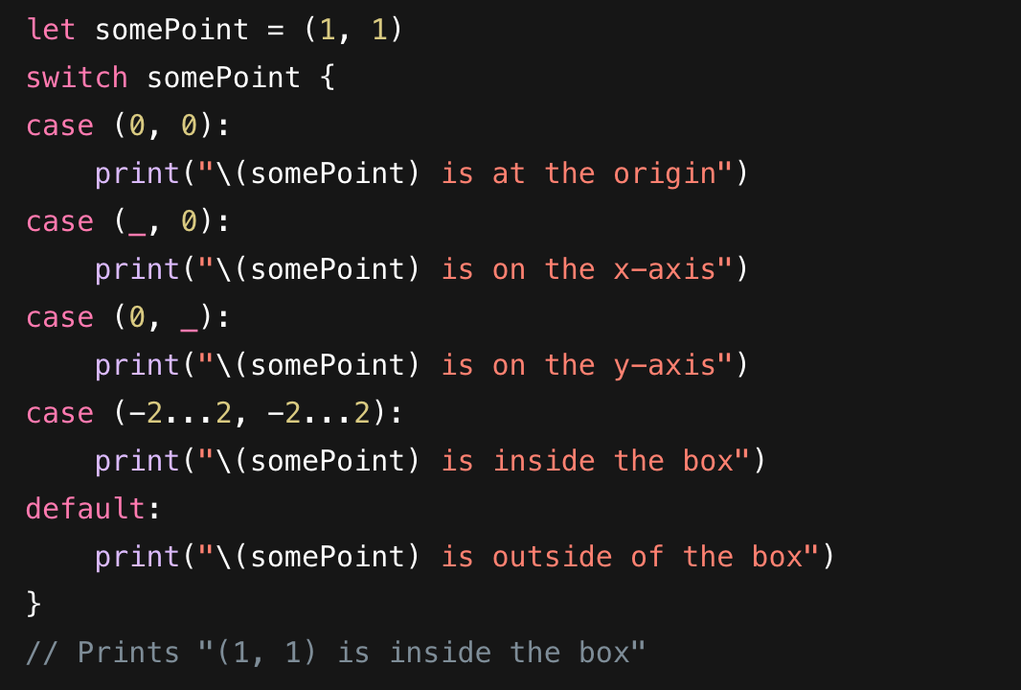
Switch in Swift
In Swift, we can also use tuples in switch statements.

Slide 37
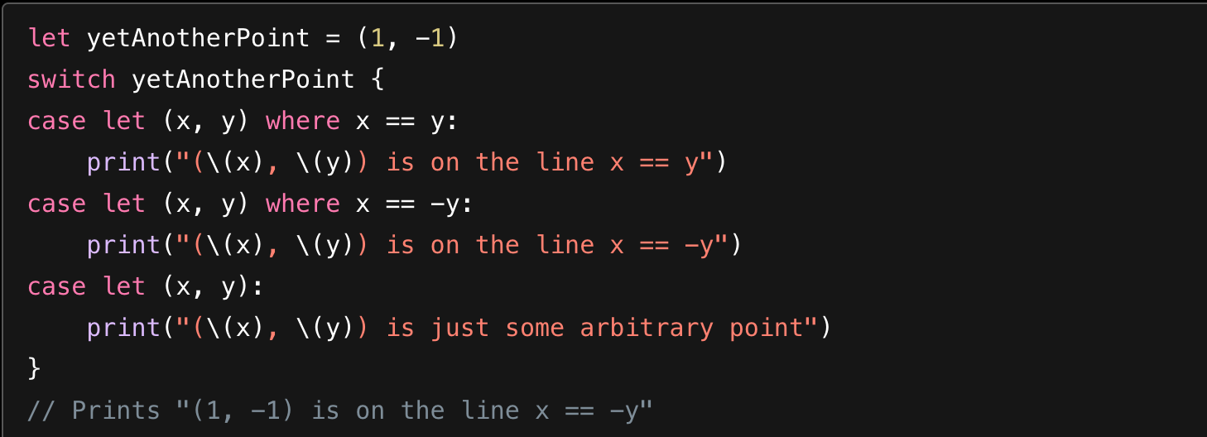
Switch in Swift
A switch case can also use a where clause to check for additional conditions.

Slide 38
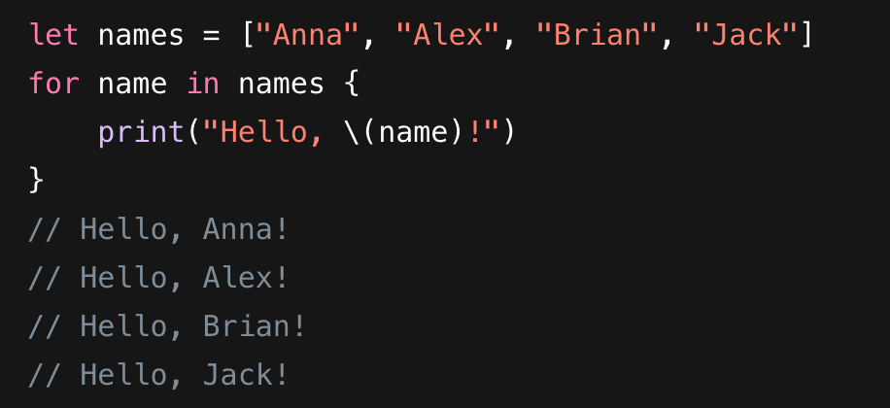
Loop in Swift
For-In Loops : It is used to iterate over a sequence, such as items in an array, ranges of numbers, characters in a string, numeric ranges, dictionaries.

Slide 39
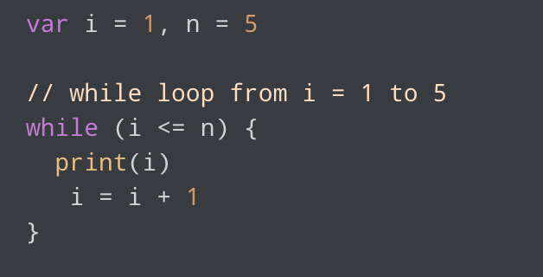
Loop in Swift
While and repeat while : These are used to run a specific code until a certain condition is met.

Slide 40
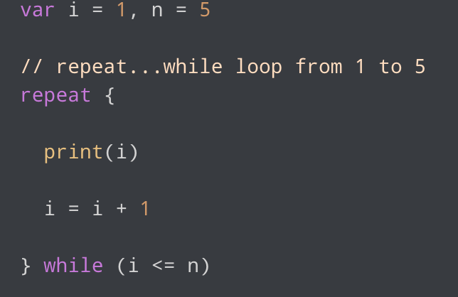
Loop in Swift
While and repeat while : These are used to run a specific code until a certain condition is met.

Slide 41
Function in Swift
Syntax of function defining in Swift:
func functionName(parametername1: datatype,parametername2: datatype,.......)-> Return Datatype {
// function body statements….
}
Syntax of function calling in Swift:
functionName(argumentlabel1: actual_value1,...)

Slide 42
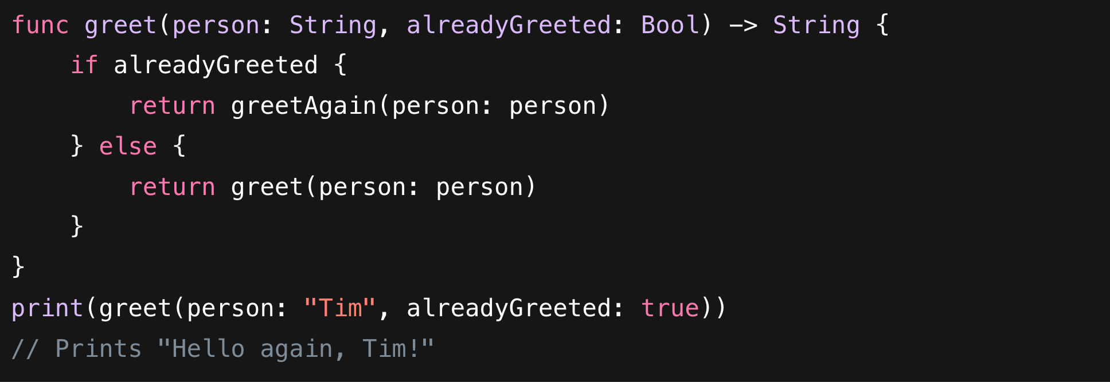
Function in Swift

Slide 43
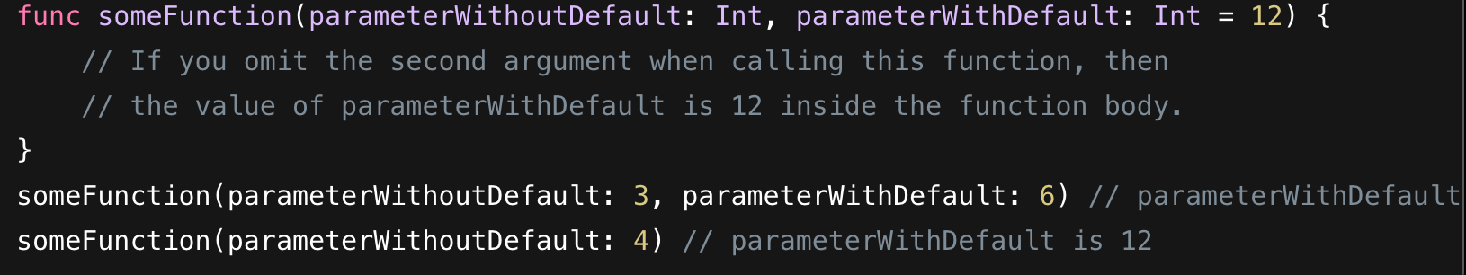
Function in Swift
We can define a default value for any parameter in a function by assigning a value to the parameter after that parameter’s type. If a default value is defined, we can parameter when calling the function.

Slide 44
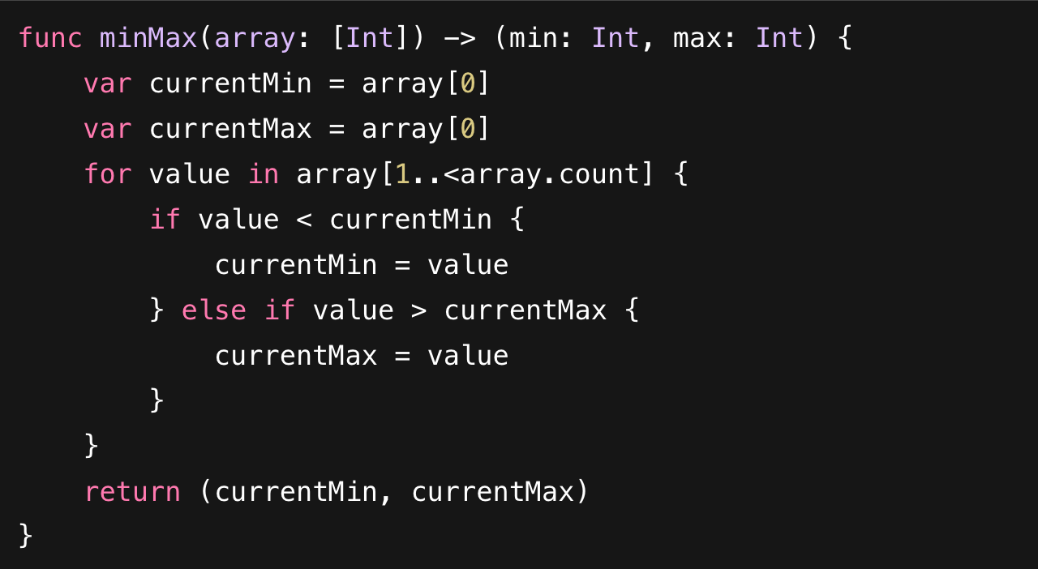
Function in Swift
We can use a tuple type as the return type for a function to return multiple values as part of one compound return value.

Slide 45
Function in Swift
A variadic parameter accepts zero or more values of a specified type.
We use a variadic parameter to specify that the parameter can be passed a varying number of input values when the function is called.
A variadic parameters by is defined by inserting three period characters (...) after the parameter’s type name.
A function can have multiple variadic parameters

Slide 46
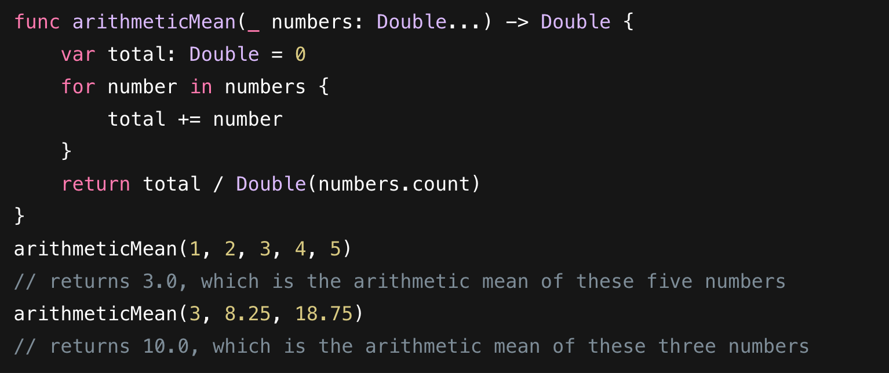
Function in Swift

Slide 47
Closure in Swift
A closure is a special type of function without the function name
Syntax:
{ (parameters) -> returnType in
// statements
}
We don't use the func keyword to create closure

Slide 48
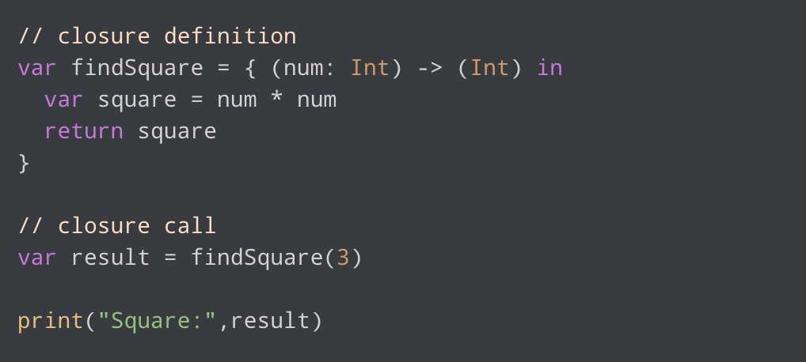
Closure in Swift

Slide 49
Closure in Swift
A closure can capture constants and variables from the surrounding context in which it’s defined. The closure can then refer to and modify the values of those constants and variables from within its body, even if the original scope that defined the constants and variables no longer exists.
In Swift, the simplest form of a closure that can capture values is a nested function, written within the body of another function.
For a more clear understanding, see the documentation .

Slide 50
Closure in Swift
var counter = 0
let incrementor = {
counter += 1 // The closure "captures" the counter variable
print("The count is \(counter)") }
incrementor()
incrementor()
The count is 1
The count is 2

Slide 51
Passing a closure as a function argument
func fetchData(source: String, onComplete: (Bool) -> Void) {
print("Fetching data from \(source)...")
let success = true
// Execute the closure that was passed in
onComplete(success)
}

Slide 52
Passing a closure as a function argument
fetchData(source: "Server 1", onComplete: { (isSuccess) in
if isSuccess {
print("Done!")
}
})
fetchData(source: "Server 2") { isSuccess in
print("Download finished with status: \(isSuccess)")
}

Slide 53
Passing a closure as a function argument
func mathOperation(a: Int, b: Int, operation: (Int, Int) -> Int) {
let result = operation(a, b)
print("Result is: \(result)")
}
mathOperation(a: 5, b: 3) { $0 + $1 } // Result: 8
mathOperation(a: 5, b: 3) { $0 * $1 } // Result: 15

Slide 54
func makeIncrementer(amount: Int) -> () -> Int {
var total = 0
let incrementer: () -> Int = {
total += amount // It remembers 'total' between calls
return total
}
return incrementer
}
let incrementByTen = makeIncrementer(amount: 10)
print(incrementByTen()) // Output: 10
print(incrementByTen()) // Output: 20
print(incrementByTen()) // Output: 30 (It remembered!)

Slide 55
Reference
Web
Documentation
Programiz

